Slide 1
MLL Resolution
Error function fitting

Slide 2
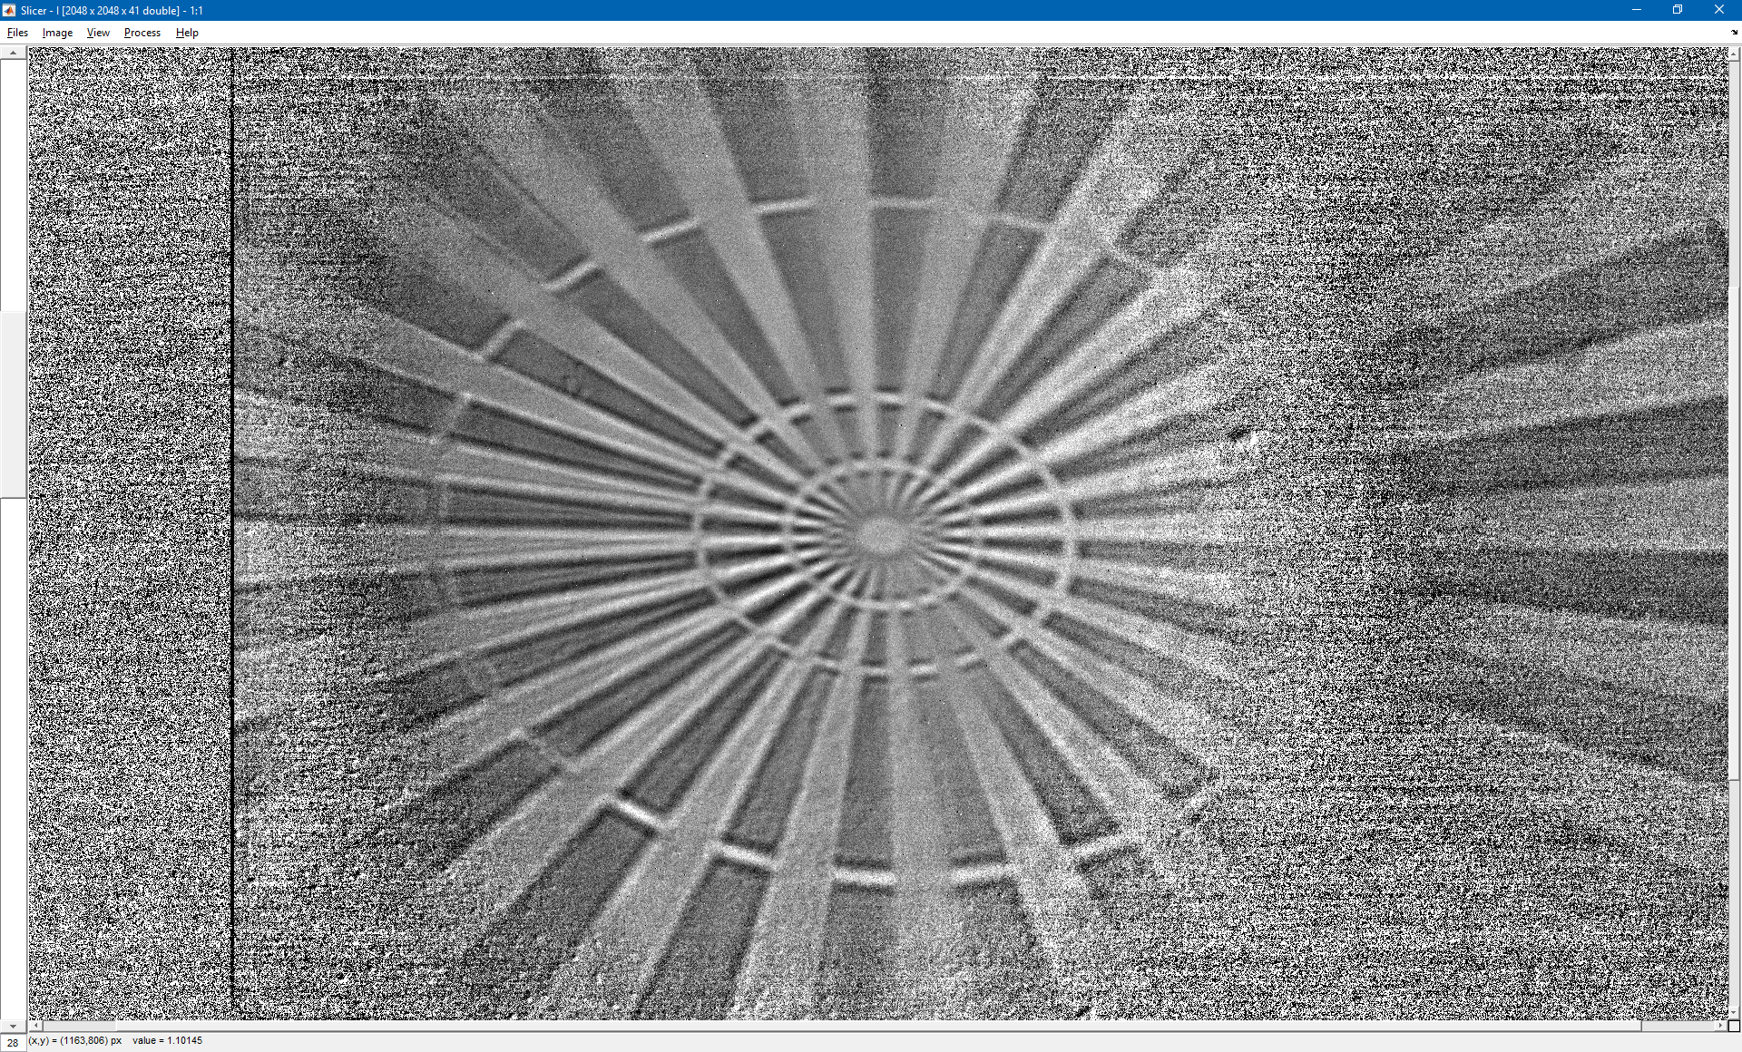
Horizontal line top

Slide 3
Horizontal line top fit
Fitting an error function with a width corresponding to the RMS of a Gaussian convolution of a sharp step. So the reported resolution (σ) is the RMS width of the point spread function.
The error on the fit is given at 1 standard deviation.
σ = (43.5±5.8) nm
M = 60.8

Slide 4
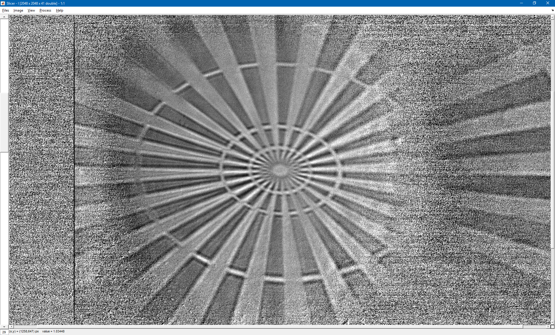
Horizontal line bottom

Slide 5
Horizontal line bottom fit
σ = (33.5±7.7) nm
M = 60.8

Slide 6
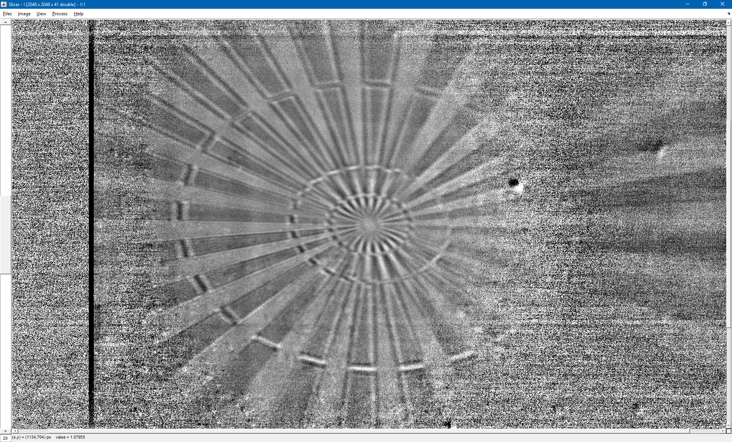
Vertical line left

Slide 7
Vertical line left fit
σ = (24.9±4.8) nm
M = 46.0

